Slide 1


Slide 2


Disaster Allocation System
Second Year Project Synopsis Submitted by
26E2033 - ByteX
ROLL | NAME
2401010056 | Ananya Sharma
2401010055 | Diksha Kumari
2401010113 | Krishika Sinha
2401010033 | Taniya
2401010063 | Shikha
Faculty Mentor: Mr. Nandan Kumar Mishra
Notes:
New Courses replaced with New Programmes

Slide 3


Project Overview
• Disaster Resource Allocation System is designed to support efficient management of resources during emergency situations such as floods, earthquakes, and fires.
• The system helps record disaster information and manage available resources like food supplies, medical kits, and rescue teams.
• It provides a structured way to organize disaster data and track resources needed in affected areas.
• The backend of the system is developed using FastAPI, which handles API requests and system operations.
• MongoDB is used as the database to store disaster details and resource information.
• The main goal of the project is to improve resource distribution and support better decision-making during disaster management.
Notes:
New Courses replaced with New Programmes

Slide 4
Specific Objectives
• To design and develop a Disaster Resource Allocation System for efficient disaster management.
• To store and manage disaster-related information such as disaster type, location, and severity in a centralized database.
• To maintain and manage available resources such as food supplies, medical kits, shelters, and rescue teams.
• To allocate resources efficiently based on disaster severity and location.
• To develop backend APIs for handling disaster data, resource data, and allocation processes.
• To ensure secure and reliable storage of disaster information using a database system.
• To support effective decision-making during emergency situations through structured data management.
• To build a scalable system that can be integrated with a user interface for monitoring disaster response activities.
Notes:
New Courses replaced with New Programmes

Slide 5
Key Features
• Disaster information management system
• Resource management module for tracking available resources
• Automated resource allocation functionality
• Centralized database for storing disaster and resource data
• Backend API system for handling system operations
• Scalable architecture for future frontend integration
• Structured data management for better disaster response
• Easy monitoring and tracking of disaster-related information
Notes:
New Courses replaced with New Programmes

Slide 6
Progress Summary
The Disaster Resource Allocation System has been successfully completed with all major components fully developed and integrated. The system architecture has been designed and implemented to efficiently manage disaster information and resource distribution in an organized manner.
The backend of the system has been developed using FastAPI, with MongoDB integrated as the database for storing disaster and resource data. APIs have been created and fully implemented to handle disaster management, resource management, and resource allocation operations.
A functional frontend interface has also been developed, enabling users to interact with the system effectively. The APIs have been thoroughly tested using Swagger to ensure accurate data storage, retrieval, and smooth system operation.
The completed system includes a well-structured workflow covering disaster reporting, resource tracking, allocation, and monitoring, ensuring efficient and transparent disaster management.
Notes:
New Courses replaced with New Programmes

Slide 7
Detailed Progress – Development Phase
During the implementation phase, the core structure of the Disaster Resource Allocation System was successfully developed and completed. The backend was built using FastAPI, which provides APIs for handling disaster data, resource data, and resource allocation processes.
MongoDB was integrated as the database to store disaster information and available resources in a structured format. Separate collections were created for disasters, resources, and allocation data to ensure organized storage and efficient data retrieval.
APIs were fully implemented for adding disaster details, managing available resources, and performing resource allocation operations. These APIs were tested using Swagger UI to verify accurate data storage, retrieval, and smooth system functionality.
In addition, a functional frontend interface was developed to allow users to interact with the system by entering disaster information, managing resources, and viewing outputs.
This phase resulted in the successful completion of the system, ensuring that all core functionalities related to disaster management and resource allocation are working effectively.
Notes:
New Courses replaced with New Programmes

Slide 8
Detailed Progress – Development Phase
Final Implementation Includes:
• System architecture design and implementation
• Backend development using FastAPI
• MongoDB database integration
• Disaster and resource management APIs
• Resource allocation functionality
• Frontend interface development
• API testing and validation using Swagger
Notes:
New Courses replaced with New Programmes

Slide 9
Methodology
• Requirement Analysis – Understanding the need for a system to manage disasters and allocate resources efficiently.
• System Design – Planning the system architecture and defining how different components of the system will work together.
• Backend Development – Developing APIs using FastAPI to manage disaster data, resource data, and allocation processes.
• Database Integration – Using MongoDB to store and manage disaster and resource information.
• Frontend Development – Creating a basic user interface to interact with the system.
• API Testing – Testing APIs using Swagger UI to ensure proper data storage and retrieval.
• System Integration – Ensuring that the different components of the system work together smoothly.
Notes:
New Courses replaced with New Programmes

Slide 10

Prototype/Project Flow diagram/Architecture
System Flow:
User accesses the system through a web browser
User registers or logs into the system
Authentication module verifies credentials
User is redirected to the dashboard
User performs operations such as:
Disaster data collection
Resorce Management
Resource allocation
Monitoring and tracking
Reporting and logging
Notes:
New Courses replaced with New Programmes

Slide 11
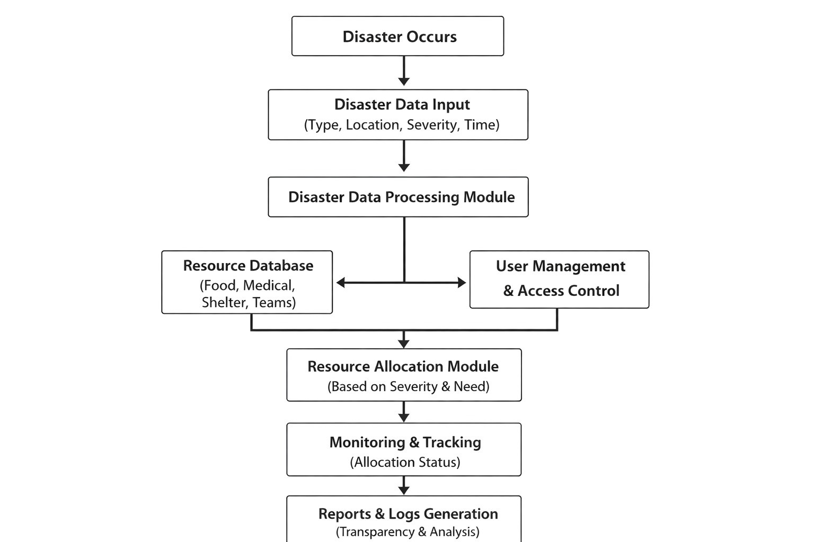
Prototype/Project Flow diagram/Architecture
Backend processes requests and interacts with MongoDB.
Updated information is displayed on the frontend.
Notes:
New Courses replaced with New Programmes

Slide 12
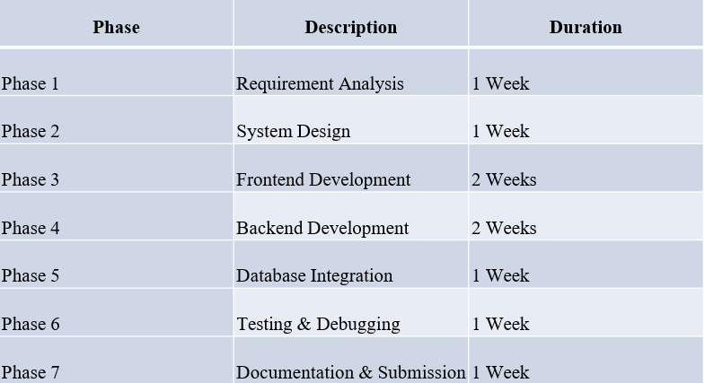
Project Timeline
Notes:
New Courses replaced with New Programmes

Slide 13
Data & Resources
Data
The system manages different types of data related to disaster situations and available resources. This includes disaster information such as disaster type, location, and severity level. It also stores resource-related data such as food supplies, medical kits, rescue teams, and other emergency support resources required during disaster response.
All this data is stored in a MongoDB database, which allows flexible storage and easy retrieval of disaster and resource information.
Resources
The project uses various technologies and tools for development and implementation:
• FastAPI – Used to develop the backend APIs. • MongoDB – Used as the database for storing disaster and resource data. • HTML, CSS, JavaScript – Used to create the frontend user interface. • Swagger UI – Used for testing and verifying API functionality. • Python – Programming language used for backend development. • Visual Studio Code – Development environment used for coding and testing.
Notes:
New Courses replaced with New Programmes

Slide 14
Project Usecases & Scope
Use Case 1: User Registration and Login
Users register with valid credentials and log into the system to access authorized features.
Use Case 2: Disaster Information Management
Authorized users can add, update, and manage disaster-related data such as location, type, and severity.
Use Case 3: Resource Management
Administrators manage resource inventory, including availability and status.
Use Case 4: Resource Allocation
Resources are allocated to affected areas based on priority and disaster severity.
Use Case 5: Monitoring and Tracking
Authorities monitor disaster response activities and track allocated resources.
Notes:
New Courses replaced with New Programmes

Slide 15
Expected Results & Impact
Efficient management of disaster-related information.
Faster and more accurate resource allocation.
Improved coordination between disaster response teams.
Reduced manual effort and data redundancy.
Secure and reliable system for disaster management.
Notes:
New Courses replaced with New Programmes

Slide 16
THANK YOU

